Slide 1
Secure Data Hiding in Image Using Steganography
CAPSTONE PROJECT
Presented By:
Adarsh Pandey
Prime Institute of Engineering and Technology in CSE

Slide 2
OUTLINE
Problem Statement
Technology used
Wow factor
End users
Result
Conclusion
Git-hub Link
Future scope

Slide 3
Problem Statement
With increasing digital communication, securing sensitive information is a major challenge.
Traditional encryption methods can attract attention, making data susceptible to attacks.
This project hides secret messages within images using steganography, ensuring secure and inconspicuous data transmission.

Slide 4
Technology used
Programming Language: Python
Libraries: OpenCV (cv2), NumPy, OS, String
Platform: Works on Windows, Linux, and macOS

Slide 5
Wow factors
LSB (Least Significant Bit) Steganography ensures data is hidden
within pixel values without visible changes.
No Extra Storage Needed, as the message is embedded in the
image itself.
Custom End Marker ("END"), ensuring accurate decoding of hidden
text.
Lightweight & Efficient, working with standard image formats like
PNG and JPG.

Slide 6
End users
Cybersecurity Enthusiasts & Researchers exploring secure data transmission.
Journalists & Activists needing covert communication.
Forensic Experts & Law Enforcement for secure information sharing.
Students & Developers learning about steganography techniques.

Slide 7

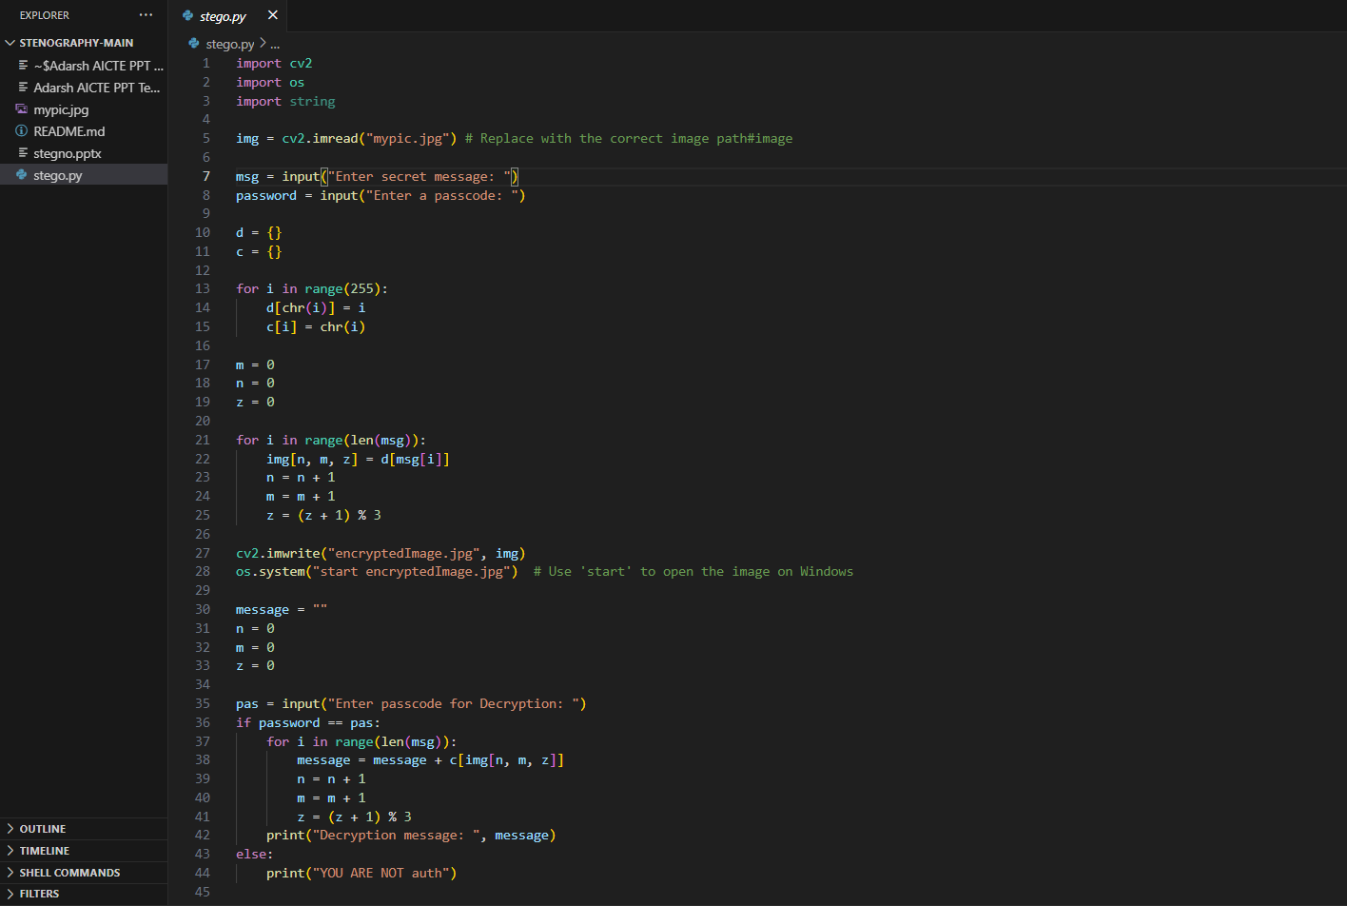
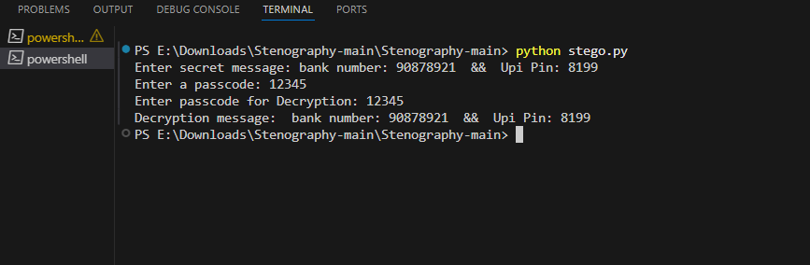
Results

Slide 8
Conclusion
This project demonstrates the power of image steganography as a secure method of concealing sensitive data. Unlike traditional encryption, it avoids suspicion while maintaining data integrity.
This technique can be further enhanced with encryption, AI-based detection evasion, or real-time processing, making it highly useful for cybersecurity, digital forensics, and secure communication.

Slide 9
GitHub Link
Make sure that there should be readme file

Slide 10
Future scope(optional)

Slide 11
THANK YOU

